Slide 2
Capstone Project - Car accident severity
By: SaYED AHMAD

Slide 3
Introduction
In this capstone I will explore and analyze a dataset collected about traffic accidents across the UK. The UK government collects and publishes (usually on an annual basis) detailed information about traffic accidents across the country. This information includes, but is not limited to, geographical locations, weather conditions, type of vehicles, number of casualties and vehicle manoeuvres, making this a very interesting and comprehensive dataset for analysis and research.
In this capstone attention will be paid to identify factors affecting the road accident and severity of these factors

Slide 4
Objectives
The objective of our project is as follows:
Find the factors affecting the road accident severity in UK.
Through visualizations and machine learning algorithms, build a model to predict the seriousness of road accident based on Weather Conditions and other important variables as accurately as possible.

Slide 5
Data Description
The data for this project is obtained from a user on Kaggle and was composed from information on the United Kingdom’s Government Open Data website.
It consists of two different datasets that contain information from 2005-2017 that were combined on a common field (Accident_Index).
Vehicle_Information.csv: A file containing information about the vehicles, point of impact, maneuvers made, driver information, etc.
Accident_Information.csv: A file containing details about the accident that include location, junction details, date

Slide 6
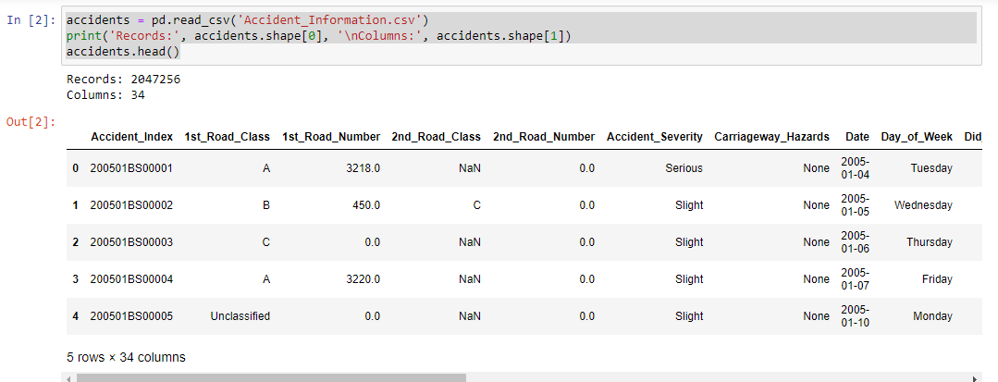
Data Description

Slide 7
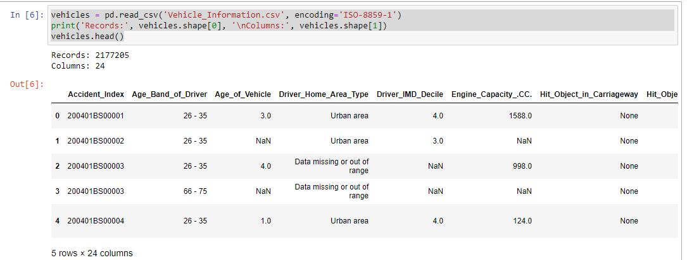
Data Description Cont..

Slide 8
Methodology
Here I will discuss the methodology used in this capstone containing main components, Data Collection, Data Understanding, Data pre-processing, Modelling, and Evaluation and Testing. This methodology consists of the following main steps:
1. Obtaining and Viewing the Data
2. Pre-processing the Data
2.1. Handling Date and Time
2.2. Handling Missing Values
2.3. Merging Dataframes
2.4. Handling Numerical Data
2.5. Handling Categorical Data
3. Modelling the Data
3.1. Train-Test-Split
3.2. Handling Imbalanced Classes
3.3. Training and Evaluating Random Forest Classifier with class weight
3.4. Training and Evaluating Random Forest Classifier with SMOTE

Slide 9
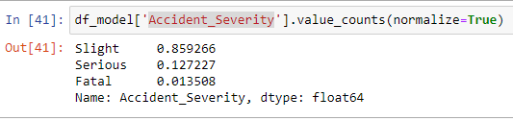
Results: Inspections In general

Slide 10
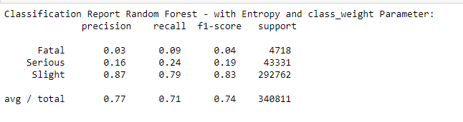
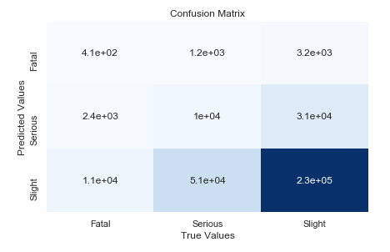
Results: Random Forest Classifier algorithm with a class_weight

Slide 11
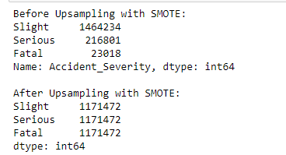
Results: Random Forest Classifier algorithm with SMOTE

Slide 12
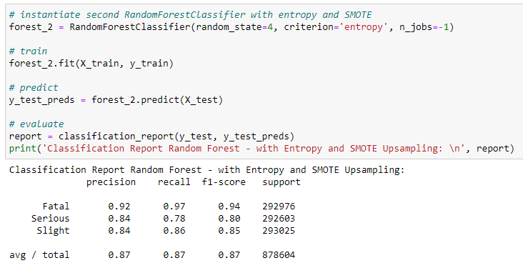
Results: Random Forest Classifier algorithm with SMOTE

Slide 13
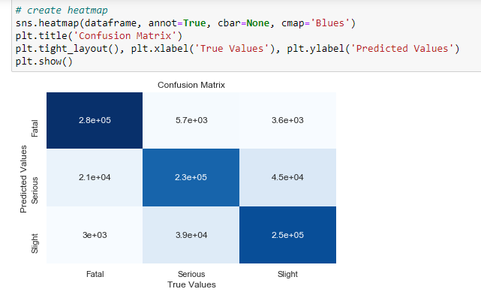
Results: Random Forest Classifier algorithm with SMOTE

Slide 14
Conclusion
It can be observed that Random SMOTE f1-score is better than the other method.

